Slide 1
Numerical Examples of STING and CLIQUE

Slide 2
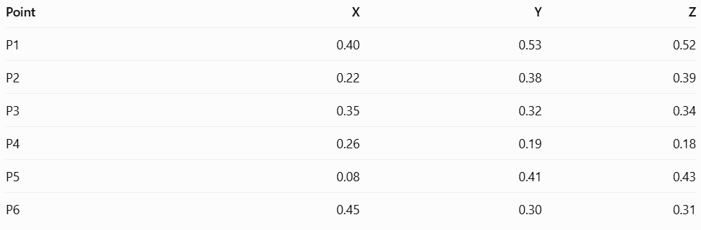
3D Dataset

Slide 3
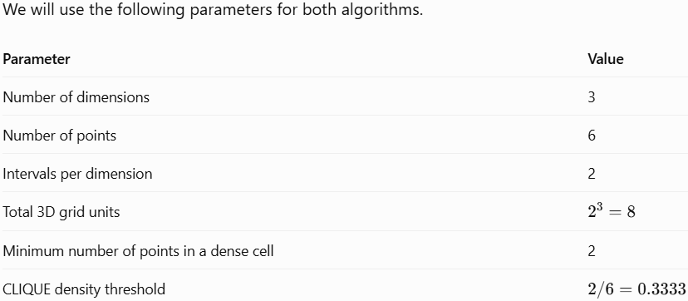
Parameters

Slide 4
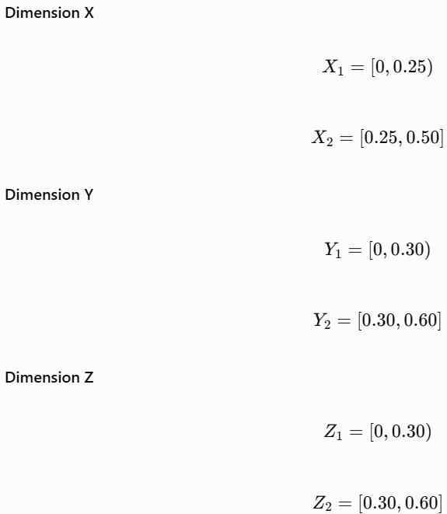

Divide each dimension into two intervals

Slide 5
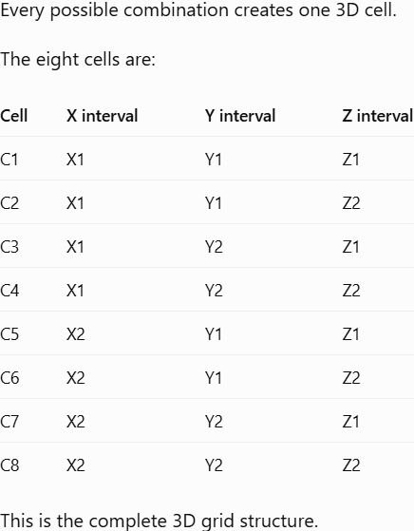
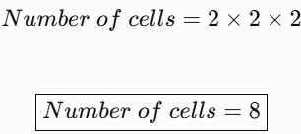
Understand the 3D grid

Slide 6
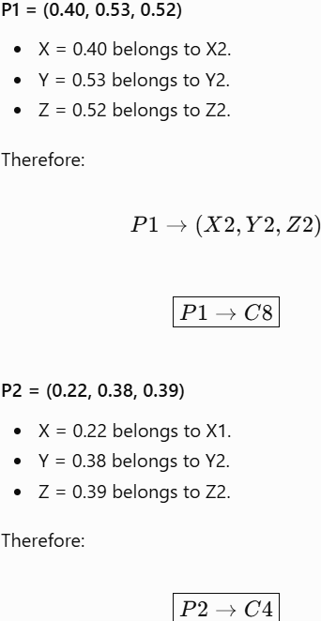
Assign the points to 3D cells

Slide 7
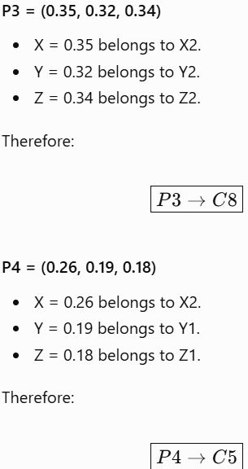

Slide 8
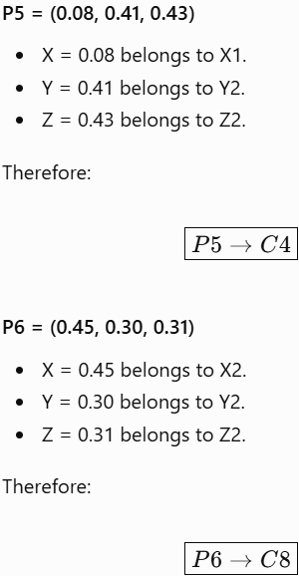

Slide 9
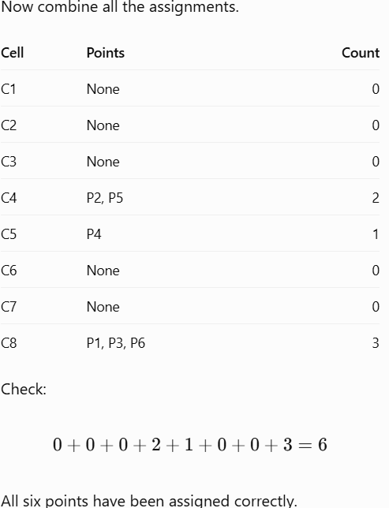
Prepare the cell distribution table

Slide 10
Calculate the statistical information for each nonempty cell
For STING, we can calculate the count, mean and other statistics for each cell.

Slide 11
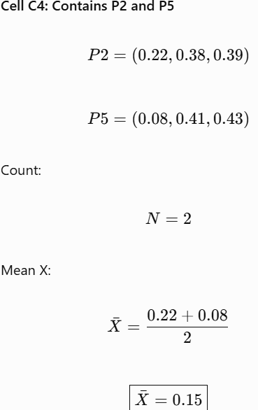
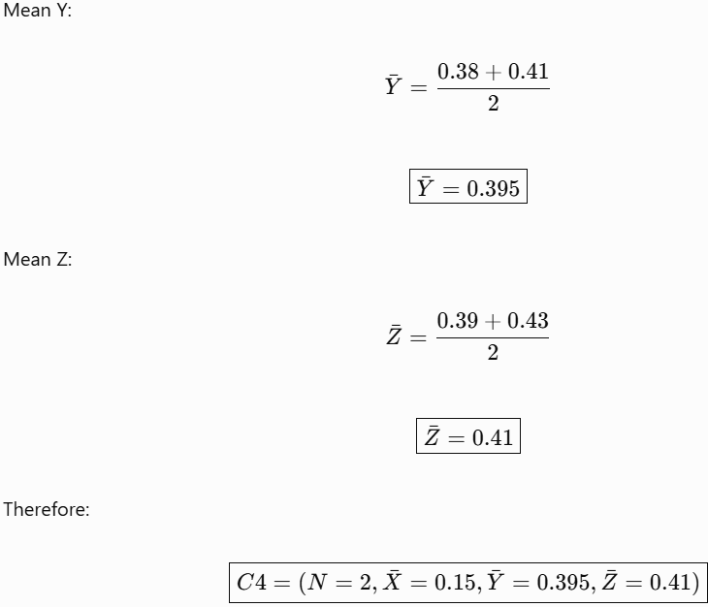

Slide 12
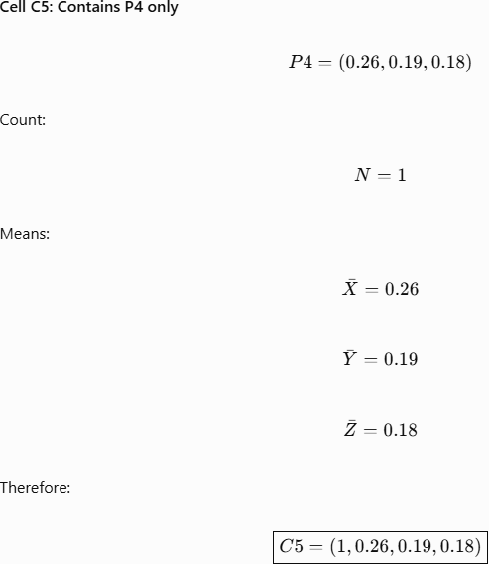

Slide 13
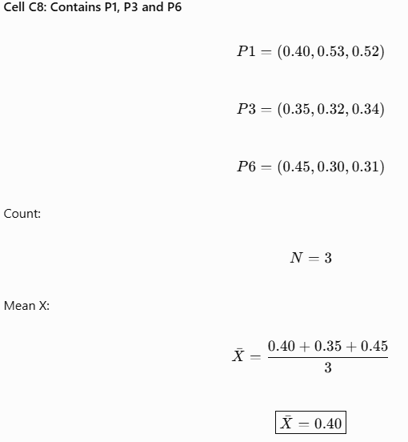
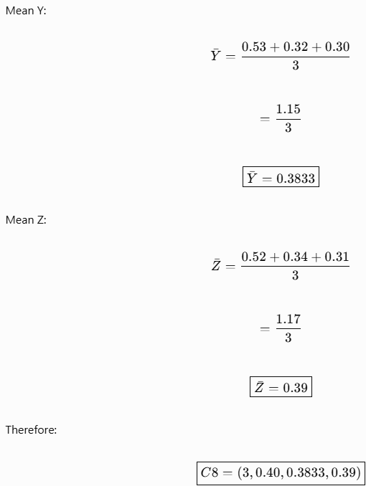

Slide 14
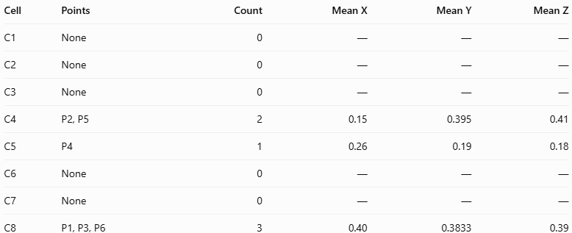
Prepare the complete statistical summary

Slide 15
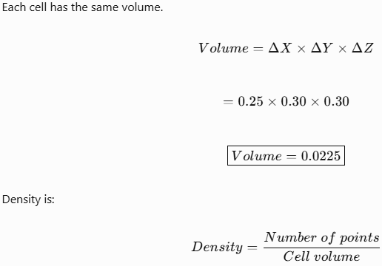
Calculate the density of each 3D cell

Slide 16
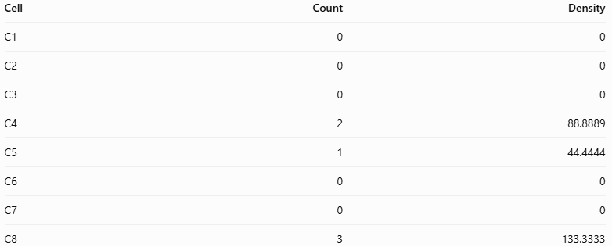

Slide 17
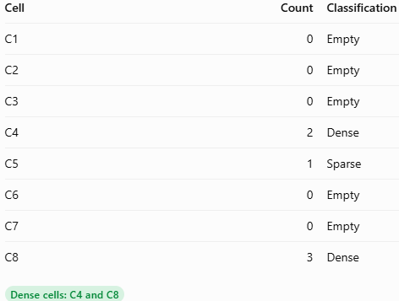
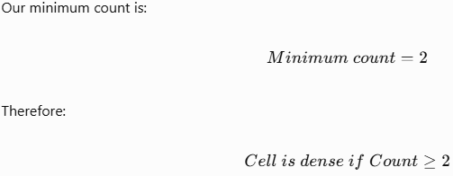
Identify dense and sparse cells

Slide 18
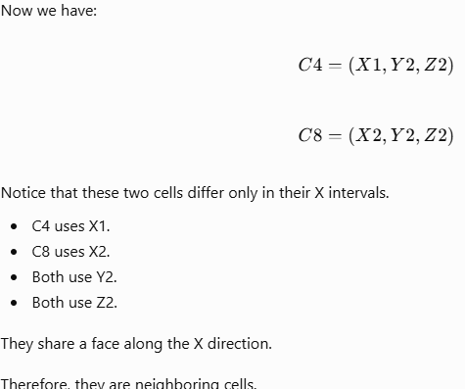
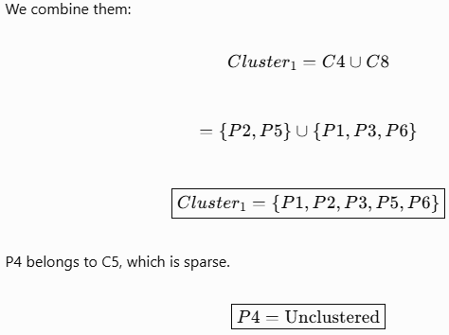
Identify neighboring dense cells

Slide 19
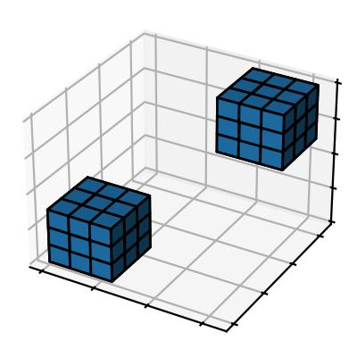
Visualize the 3D cluster
Conceptually, C4 and C8 are two neighboring cubes. They form a connected dense region in the 3D space.

Slide 20
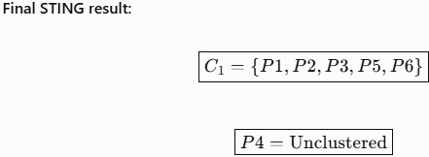

Slide 21
CLIQUE

Slide 22
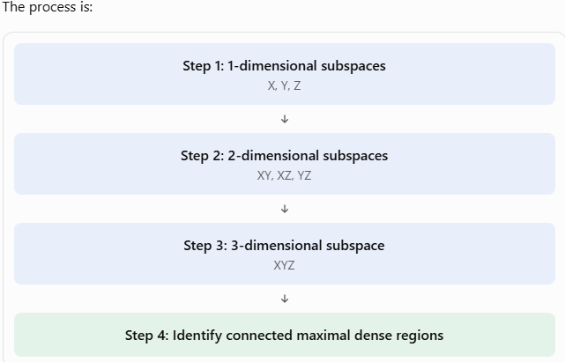

Slide 23
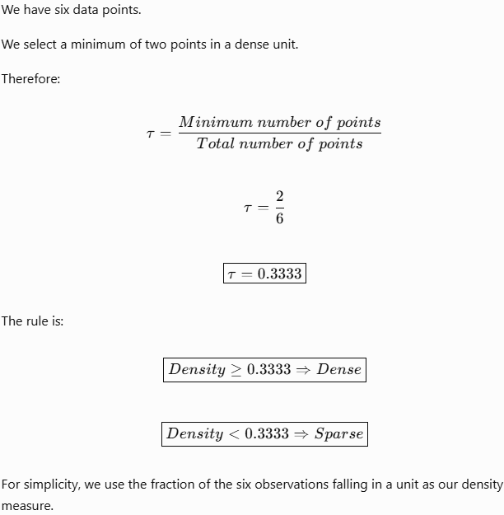
Define the density threshold

Slide 24
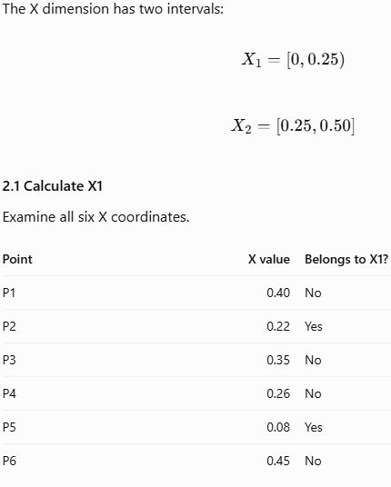
Find dense units in the X dimension

Slide 25
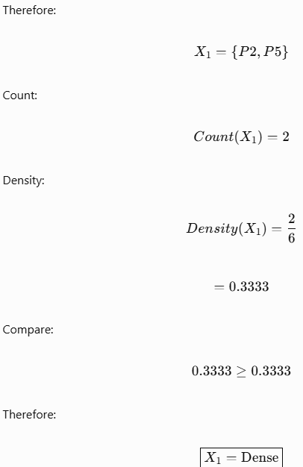

Slide 26
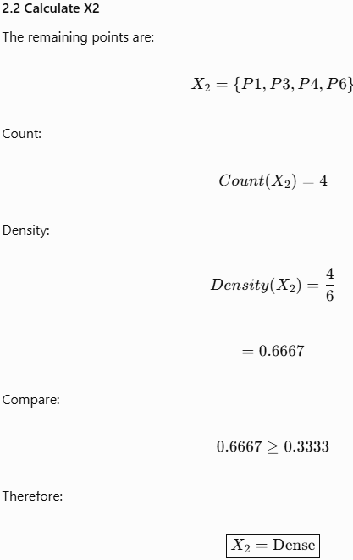

Slide 27
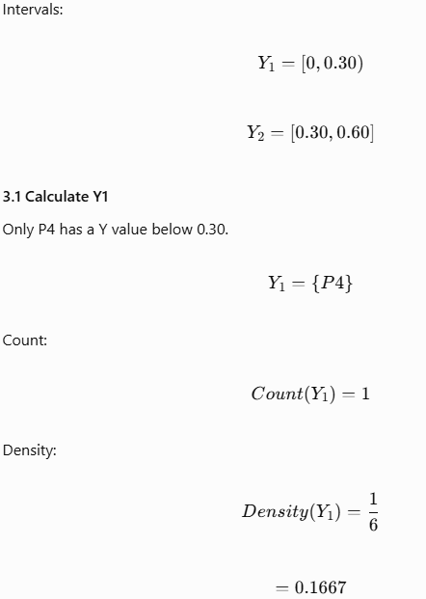
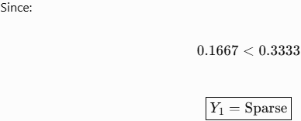
Find dense units in the Y dimension

Slide 28
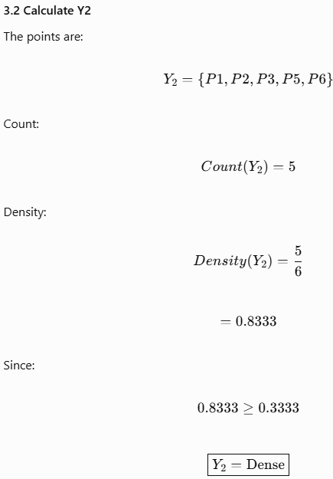

Slide 29
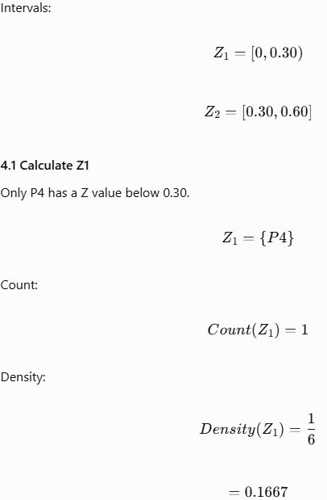

Find dense units in the Z dimension

Slide 30
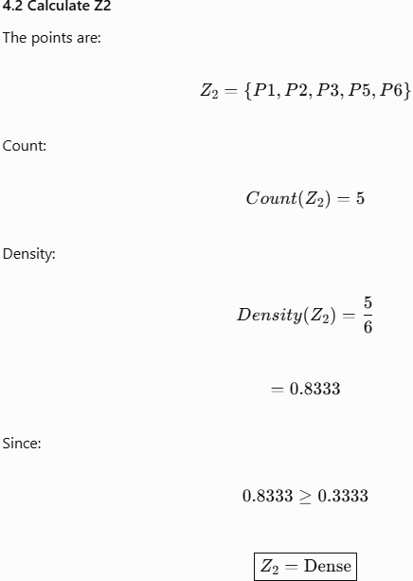

Slide 31
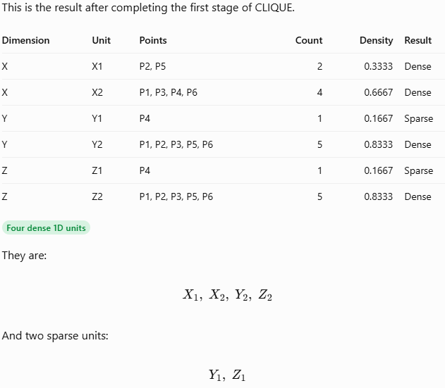
Summarize all one-dimensional units

Slide 32
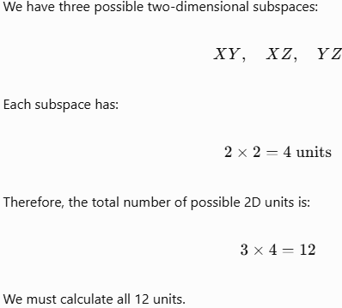
Generate two-dimensional candidate units

Slide 33
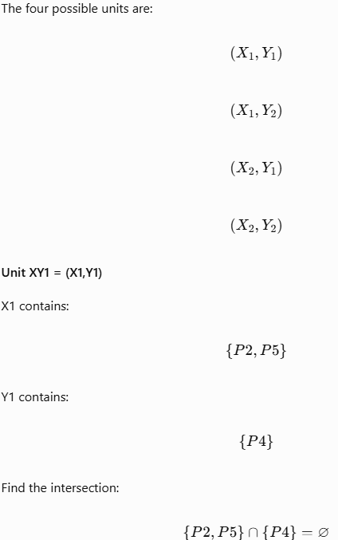
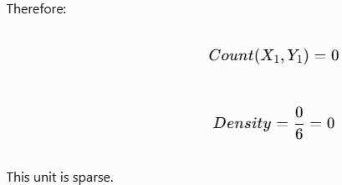
Calculate units in the XY subspace

Slide 34
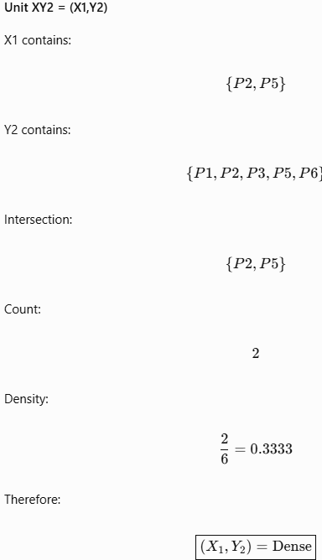

Slide 35
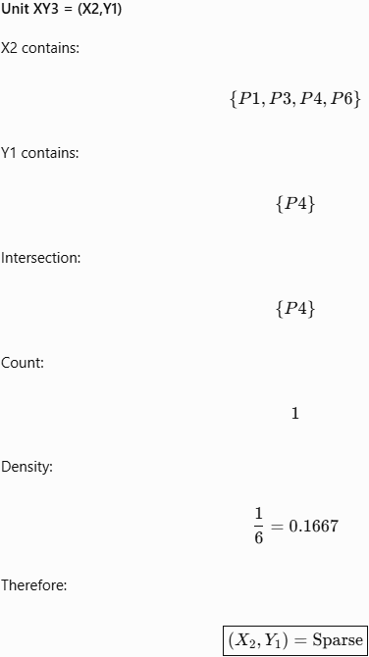

Slide 36
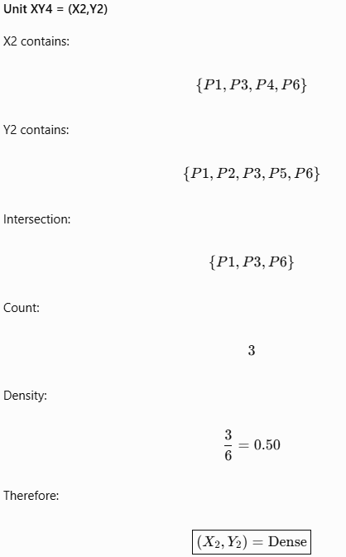

Slide 37
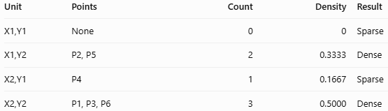
XY summary

Slide 38
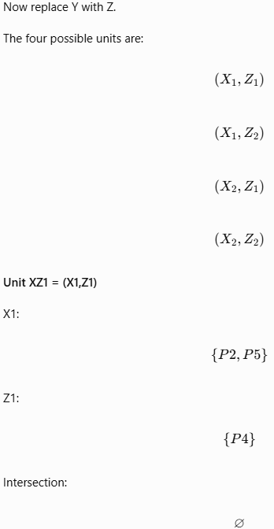
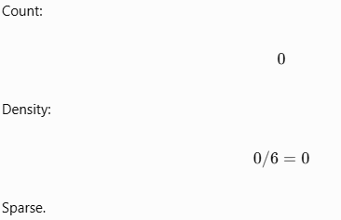
Calculate units in the XZ subspace

Slide 39
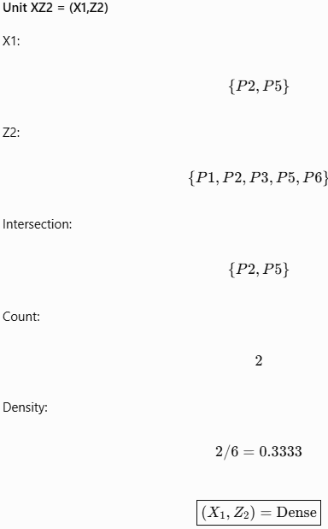

Slide 40
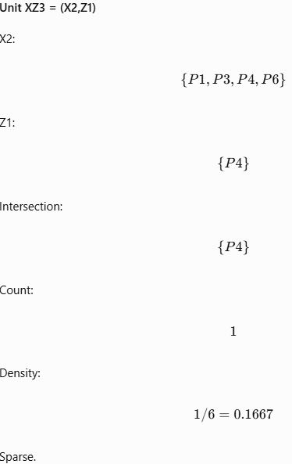

Slide 41
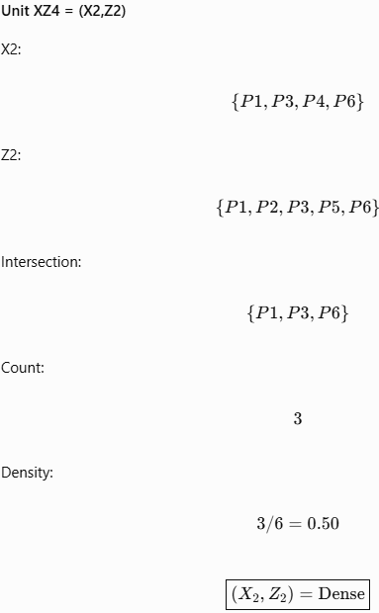

Slide 42
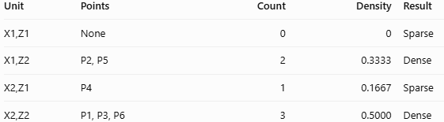
XZ summary

Slide 43
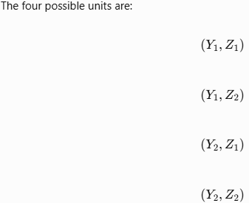
Calculate units in the YZ subspace

Slide 44
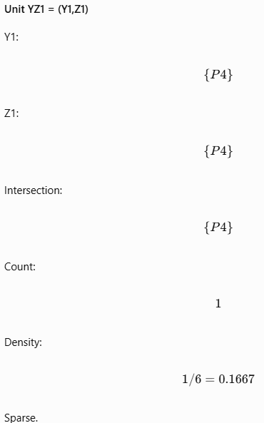

Slide 45
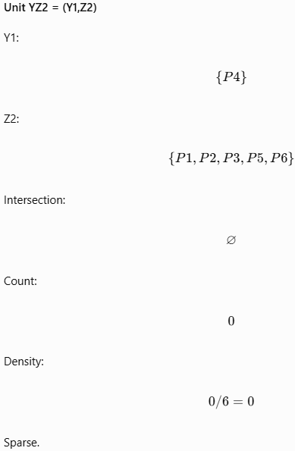

Slide 46


Slide 47


Slide 48

YZ summary

Slide 49

Combine all 2D results

Slide 50


Slide 51

Apply the Apriori property

Slide 52


Slide 53



Slide 54

Generate three-dimensional candidate units

Slide 55



Slide 56



Slide 57



Slide 58



Slide 59

Final candidate summary (Try: X1,X2,Y2,Z2)

Slide 60

Calculate the density of the remaining 3D candidates

Slide 61


Slide 62


Slide 63


Slide 64

Final 3D density table

Slide 65

Identify neighboring dense units

Slide 66


Slide 67

Final CLIQUE result

Slide 68


Slide 69


Slide 70

Spatial Database

Slide 71
The End

